Slide 1
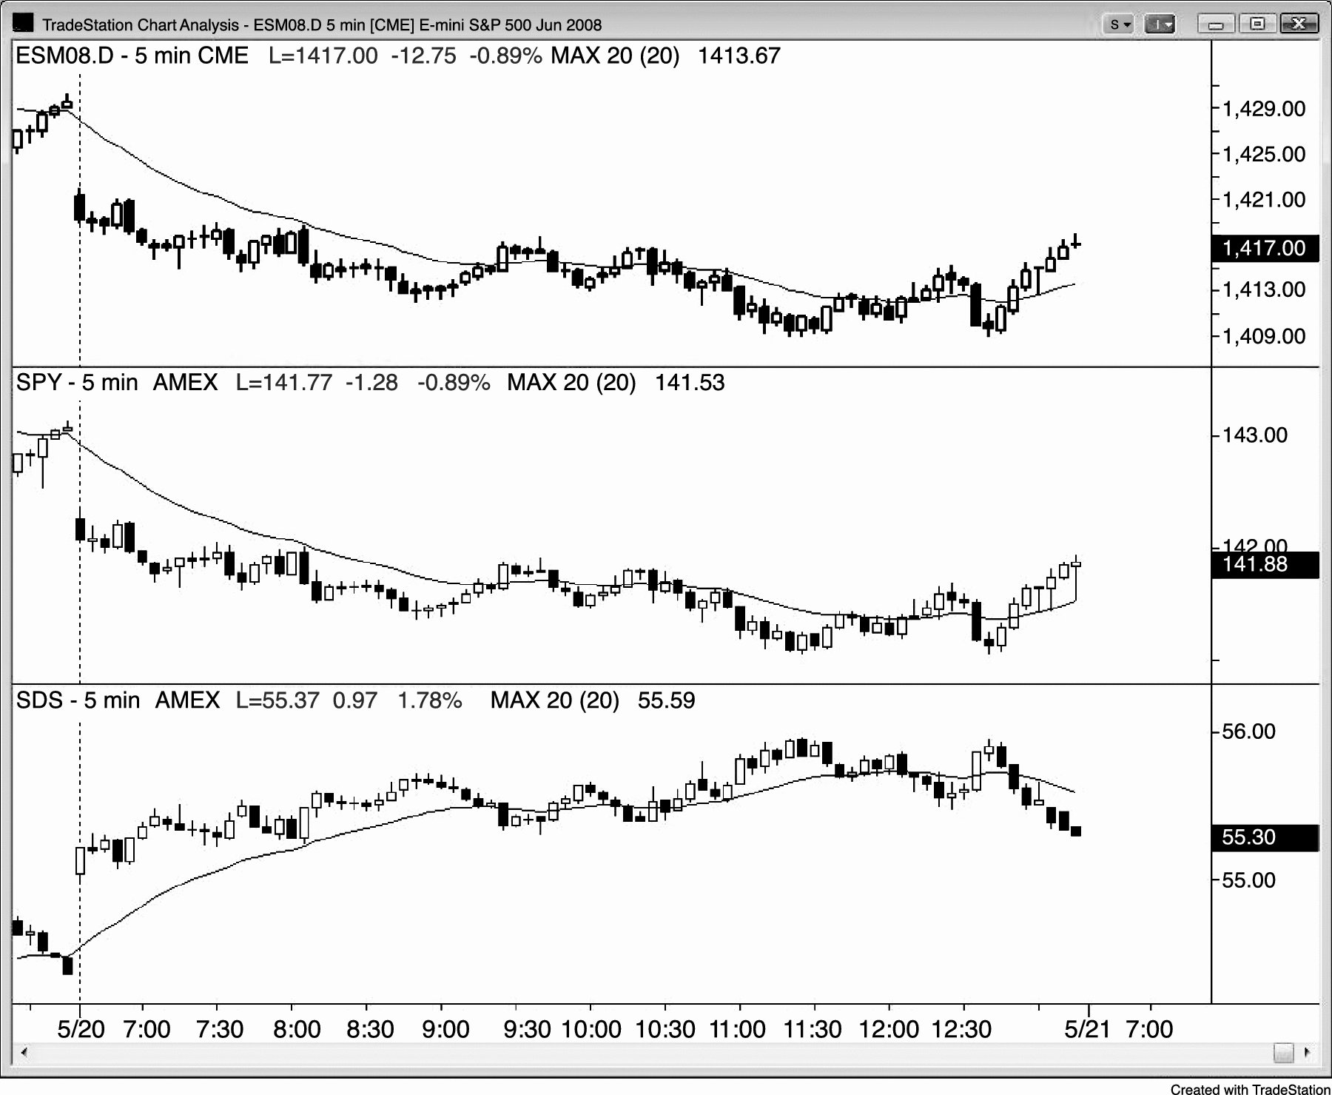
FIGURE 9.1 The Emini and the SPY Are Similar

Slide 2
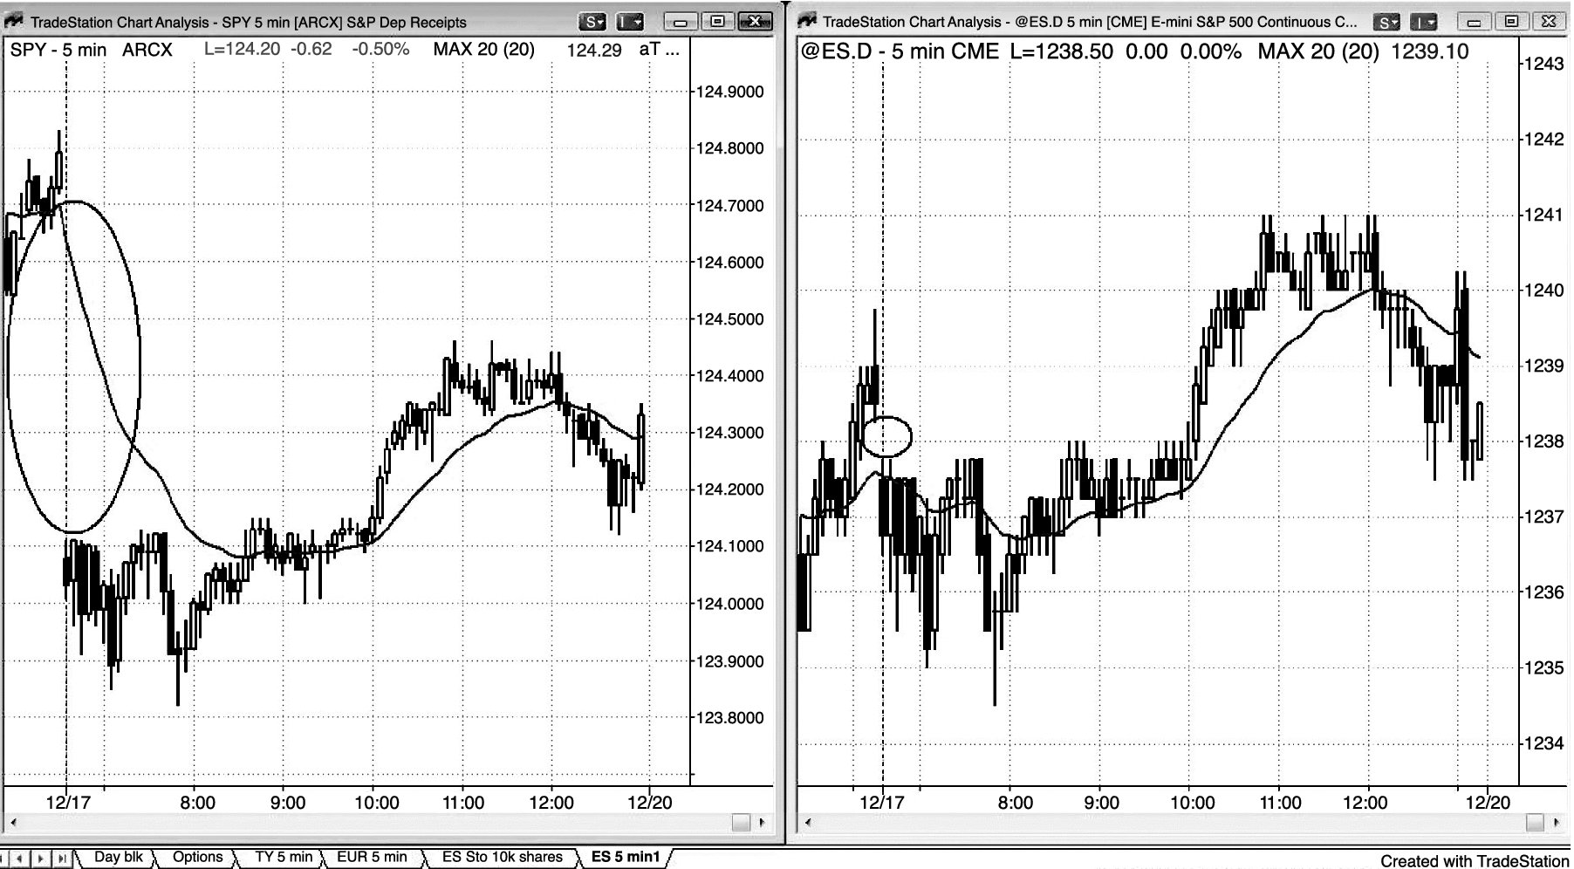
FIGURE 9.2 SPY Adjustment on Triple Witching Days

